Slide 1

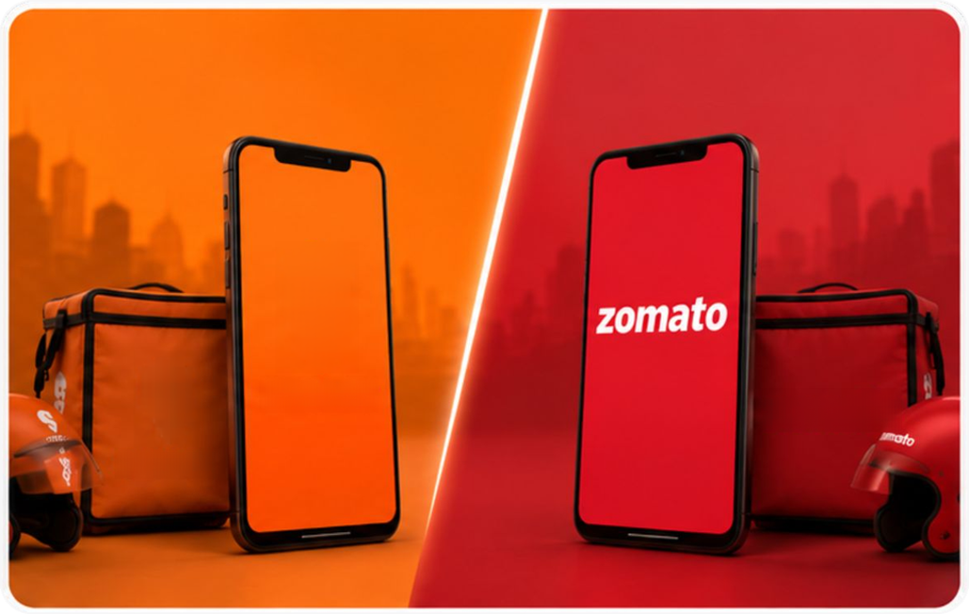













zomato
SWIGGY
A COMPARATIVE STUDY OF INDIA'S LEADING
FOOD DELIVERY PLATFORMS
SWIGGY VS ZOMATO:
Restaurant Performance and Customer Insights Analysis
SWIGGY
zomato
SWIGGY
NAME
COLLEGE NAME
Parneet Kaur
IHI
Sant Baba Bhag Singh University Jalandhar
STREAM/COURSE
ROLL NO.
B.Tech CSE AI and ML
24801076
Notes:
1.7.2013
1
‹#›

Slide 2



























A Step Towards Success
07 Services IT Company
SERVICES
An IT Company With Learning Hub
About
ISO 9001:2015 Certified
Specializations
    Web & Mobile Development
    Software Development
    Digital Marketing
    IT Integration
Locations
Headquarters: Jalandhar
Branch Office: Hoshiarpur
zomato
Project:
SWIGGY VS ZOMATO: Restaurant Performance and Customer Insights Analysis
Notes:
1.7.2013
2
‹#›

Slide 3








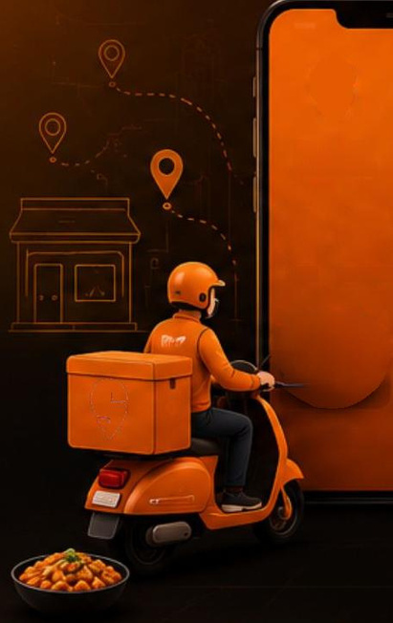
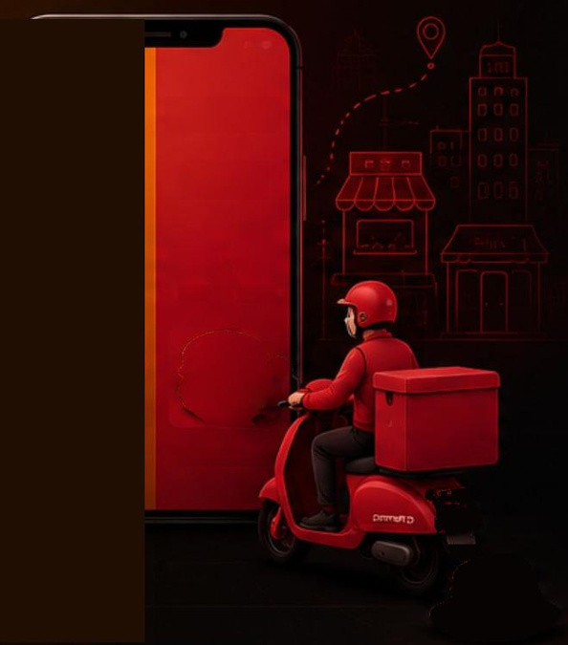




























Agenda
Table of
Contents
VS
zomato
SWIGGY
01
Introduction
06
Dashboard & Visual Analysis
zomato
SWIGGY
FOOD
DELIVERY
FOCO CIELINERY
02
Problem Statement
07
Key Insights
Food
Instamart
Food
Dining
zomato
08
Fast Delivery
Great Choices
03
Project Overview
Conclusion
04
Dataset Overview
09
Future Scope
05
Technology Used
Project:
SWIGGY VS ZOMATO: Restaurant Performance and Customer Insights Analysis
Notes:
1.7.2013
3
‹#›

Slide 4
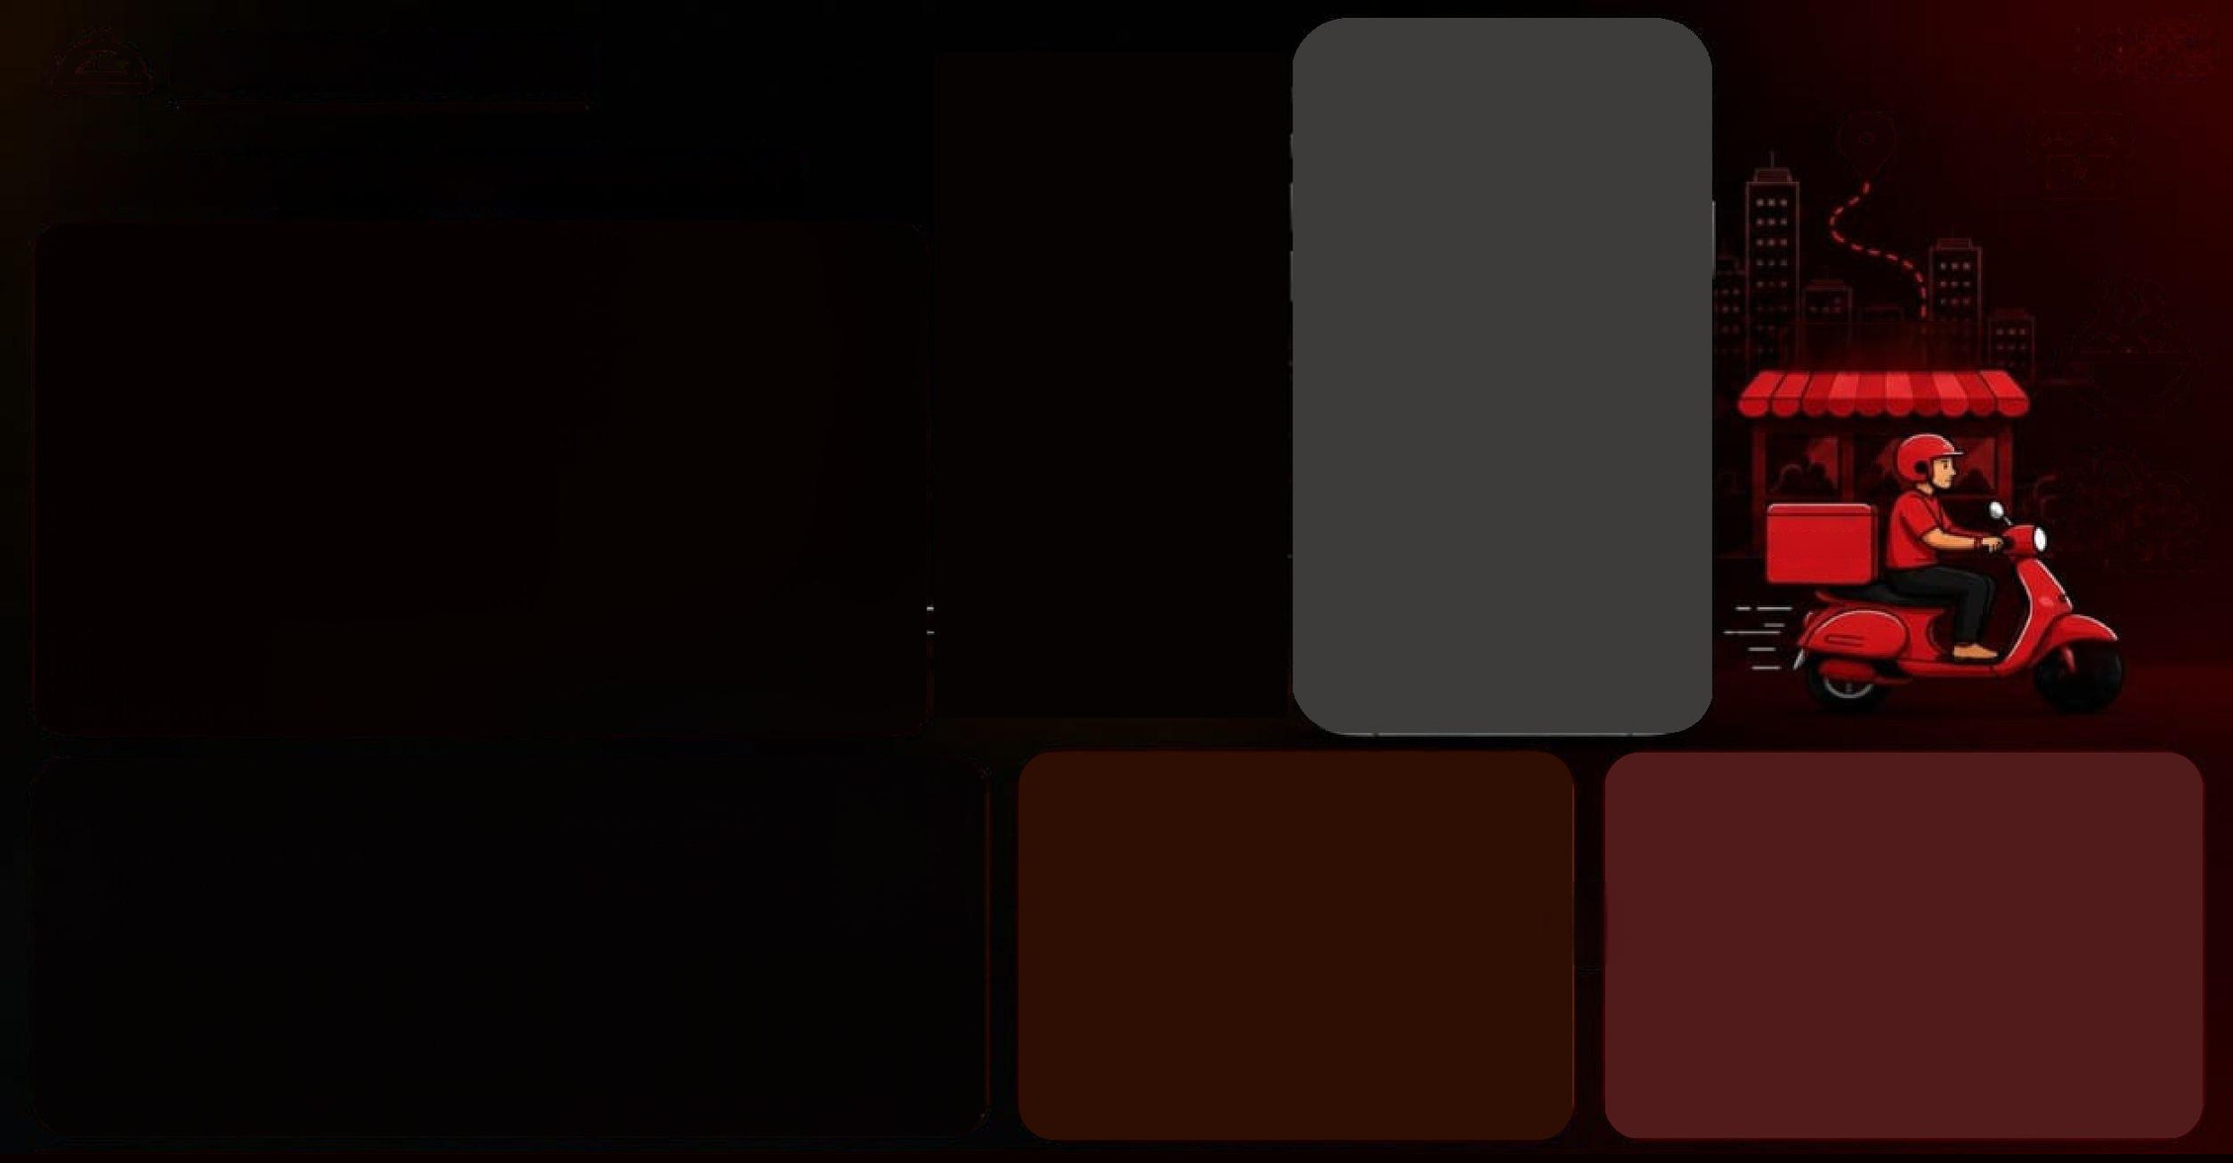

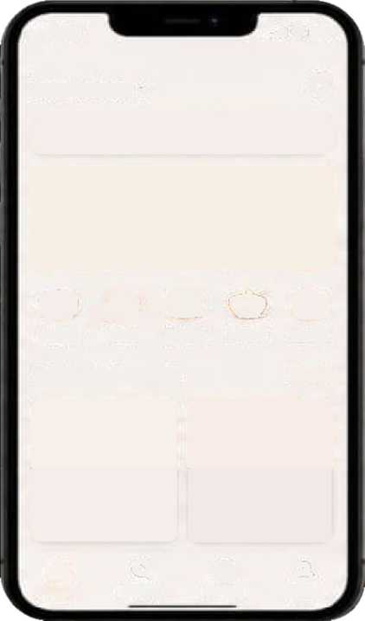




























INTRODUCTION
10:41
Deliver to
Why Compare
Your Location
Swiggy and Zomato?
Search for restaurants or cuisines
Delicious food,
delivered fast
Great food at your doorstep
RESTAURANT
RESTAURANT
This project presents a comparative analysis of Swiggy and Zomato using a structured dataset.
It evaluates key metrics such as ratings, delivery time, delivery fees, monthly orders, revenue, net profit, and market share. Using Python for data analysis and visualization, the project identifies performance trends and provides meaningful insights based solely on the available dataset.
Pizza
Biryani
Burger
Indian
Cakes
Popular Restaurants
See all
zomato
Good Bowl
Pizza House
4.3 - 30 min-₹₹
4.1 - 25 min-₹₹
North Indian, Healthy
Pizza, Italian
Home
Search
Orders
Profile
    Dataset Size: 2,500 Restaurants
    Platforms Compared: Swiggy & Zomato
    Coverage: Multiple Cities and Cuisines
    Analysis Metrics: Ratings, Delivery Time, Revenue, Market Share, Orders, Commission & Discounts
    Tools Used: Python, Pandas, Plotly, Streamlit
Project:
SWIGGY VS ZOMATO: Restaurant Performance and Customer Insights Analysis
Notes:
1.7.2013
4
‹#›

Slide 5


























THE CHALLENGE
Problem
Statement
zomato
VS
Despite the growth of online food delivery, users and restaurants still face sevaeral challenges that impacts convenience, cost-effeiciency and overall satisfaction.
This project aims to identify these challenges and compare how Swiggy and Zomato address them.
SWIGGY
Dataset-Based Comparison
Restaurant-wise Platform Analysis
Delivery Time, Ratings & Revenue
Comparison
Orders, Profit & Market Share Analysis
1.Delivery Delays
2.High Delivery Charges
3.Limited Restaurant Availability
4.Customer Satisfaction
Distance from city center, high order volume and restaurant preparation time cause delays, affecting customer satisfaction.
Long distance from City Center,Price Category and Restaurant Type are the reasons for high delivery charges.
Some areas still have limited restaurant options, reducing variety and choice for users.
Issues like late deliveries, high delivery charges and low discount frequency impact trust and long-term user loyality.
Project:
SWIGGY VS ZOMATO: Restaurant Performance and Customer Insights Analysis
0
5
Notes:
1.7.2013
5
‹#›

Slide 6

















































THE APPROACH
BEME
ర్రాలు
Project
Overview
zomato
SWIGGY
Search for rettaurants
Search for restaurarts
This project follows a structured data analysis workflow to
compare Swiggy and Zomato using the uploaded dataset.
The analysis focuses on delivery performance, ratings, pricing
revenue, profit, and other available attributes to generate
meaningful insights through Python.
FOOD YOU
DISCOVER
GREAT FOOD
NEAR YOU
DELIVERED FAST
VS
Feud
bataret
Cetueerut
Chowdhury
Drrg
Eeindn
Top Picks for You
Top Rated Restaurants
zomato
రె రె
రి తెలి
ర్ తెలిపి
ర్ తెలి
.
రె రె రె
.1
రి చి రి
రె రె
రిలెటి
.15
01
02
03
04
05
Data Cleaning &
Processing
Comparative Analysis
Data Visualization
Performance Evaluation
Data Collection
Imported and explored the
Swiggy vs Zomato dataset
(CSV) containing restaurant-
wise information from both
platforms.
Compared key metrics
including ratings, delivery
time, delivery fee, commission,
monthly orders, revenue, profit,
and market share.
Created charts and
dashboards to visualize
trends, platform performance,
and restaurant-wise
comparisons.
Handled missing values,
checked data types, removed
inconsistencies, and
prepared the dataset for
analysis.
Evaluated both platforms
using the dataset to identify
better-performing metrics
and summarize
key findings.
Project:
SWIGGY VS ZOMATO: Restaurant Performance and Customer Insights Analysis
6

Slide 7















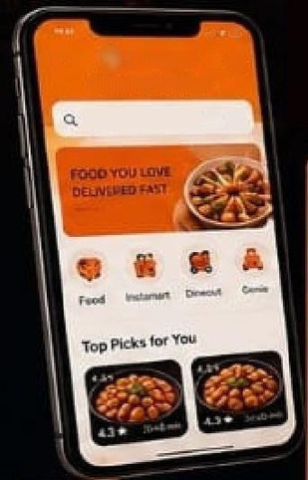
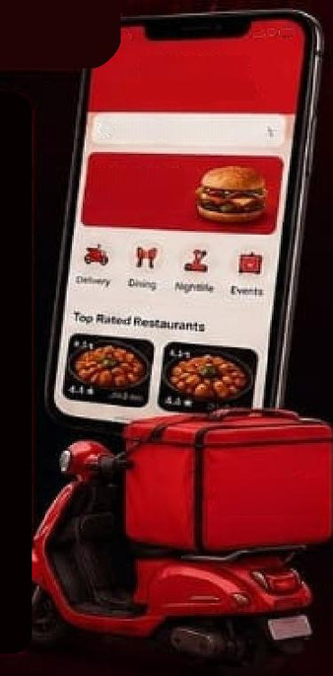
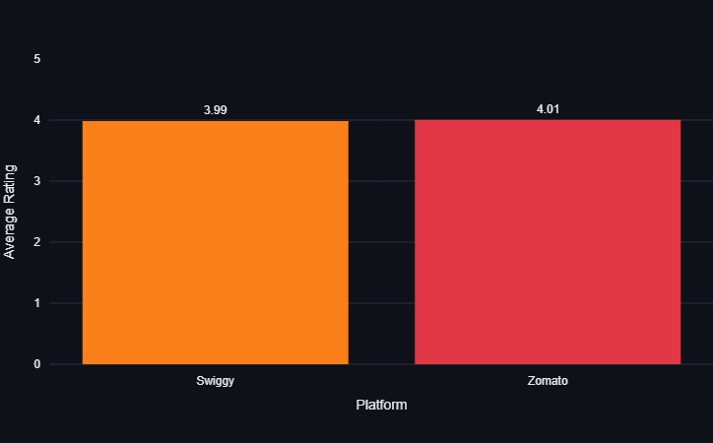






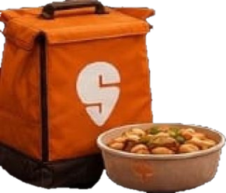














Dataset
Overview
zomato
SWIGGY
Swiggy vs Zomato Platform Comparison
2,500
Multiple
Multiple
Ratings
Financial
Complete
Total Restaurants
Cities Covered
Culsines
From Both Platforms
Data
Operational Data
Records in
the dataset
Restaurants from
different cities
and localities
Wide variety of
cuisines and restaurant
types included
Swiggy Rating.
Zomato Rating &
Average Rating
Revenue,Profit.
Orders, Commission &
Market Share
Delivery Time, Delivery
Fee, Discounts.
Opening Hours & More
9
SWIGGY
ర్
Delveneg Happiees
zomato
Key Parameters in Dataset
Beath fof reslaurants
Restaurant Details
GREAT FOOD
GREAT DEALS
Id, City, Locality, Type, Cuisines
Ratings & Reviews
Swiggy Rating, Zomato Rating, Total Reviews, Average Rating
Delivery Information
Delivery Time, Delivery Fee, Discounts
Pricing & Cost
Average Cost per Person, Price Category
Operational Details
Opening/Closing Time, Days Operational
zomato
Business & Financial Metrics
Monthly Orders, Revenue, Net Profit, Commission, Market Share
Platform Features
Amenities, Own Website, Own App, Food License Verified etc.
Source:
Swiggy vs Zomato Dataset (CSV File)
Collected from publicly available data
SWIGGY
VS
zomato
6
Project:
SWIGGY VS ZOMATO: Restaurant Performance and Customer Insights Analysis

Slide 8








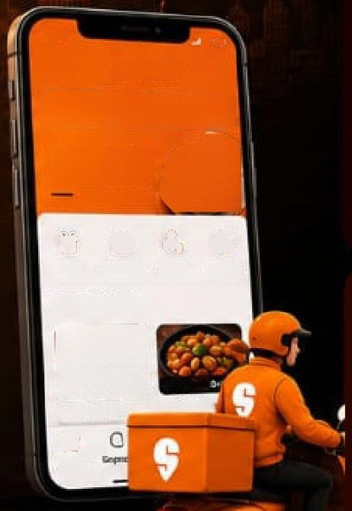
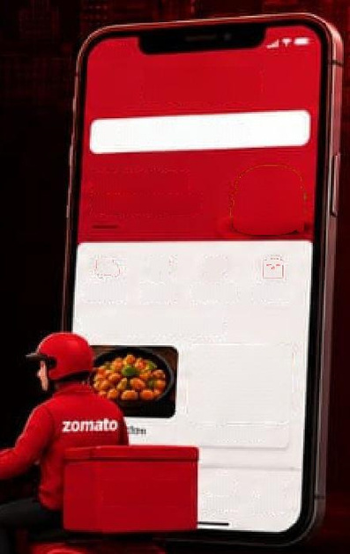




























Objectives
zomato
Discover more places.
More food.
More often.
SWIGGY
Project Goals
Food you love,
delivered.
Compare Platform
Performance
Analyse Delivery &
Pricing
01
02
5.41
రీశ్రి
SWIGGY
Compare Swiggy and Zomato
using dataset metrics such as
ratings, delivery time, monthly
orders, revenue, net profit,
and market share.
Evaluate delivery time, delivery
fee, commission, average cost
per person, and discount
frequency available in the
dataset.
zomato
0
Search for restaurants
Search for restaurants
FOOD YOU LOVE
DELIVERED FAST
GREAT FOOD
GREAT OFFERS
Food
బొల్లిచిచేసింది.
Gerie
Dineout
Deheery
Dining
Monade
Eventi
Top Picks for You
03
Evaluate Customer &
Restaurant Data
04
Generate
Data Insights
Top Rated Restaurants
సాడ
చీపాలు చిరుత
చాత్రిత
Analyse restaurant ratings, total
reviews, cuisines, restaurant
type, amenities, and operational
details from the dataset.
Create visualisations and
identify trends using Python
based only on the uploaded
Swiggy vs Zomato dataset.
45
ర్ ని శ్రీ శ్రీ
BaHLS
ర్రి-ర్రి-ర్రా
బై.చిల్లి
25-15me4
Houtl
zomato
8
8
Orders
Pro
Goal:
To perform a data-driven comparison of Swiggy and Zomato using the available CSV dataset and generate meaningful insights through Python analysis and visualization.
SWIGGY
VS
zomato
Project:
SWIGGY VS ZOMATO: Restaurant Performance and Customer Insights Analysis
5

Slide 9
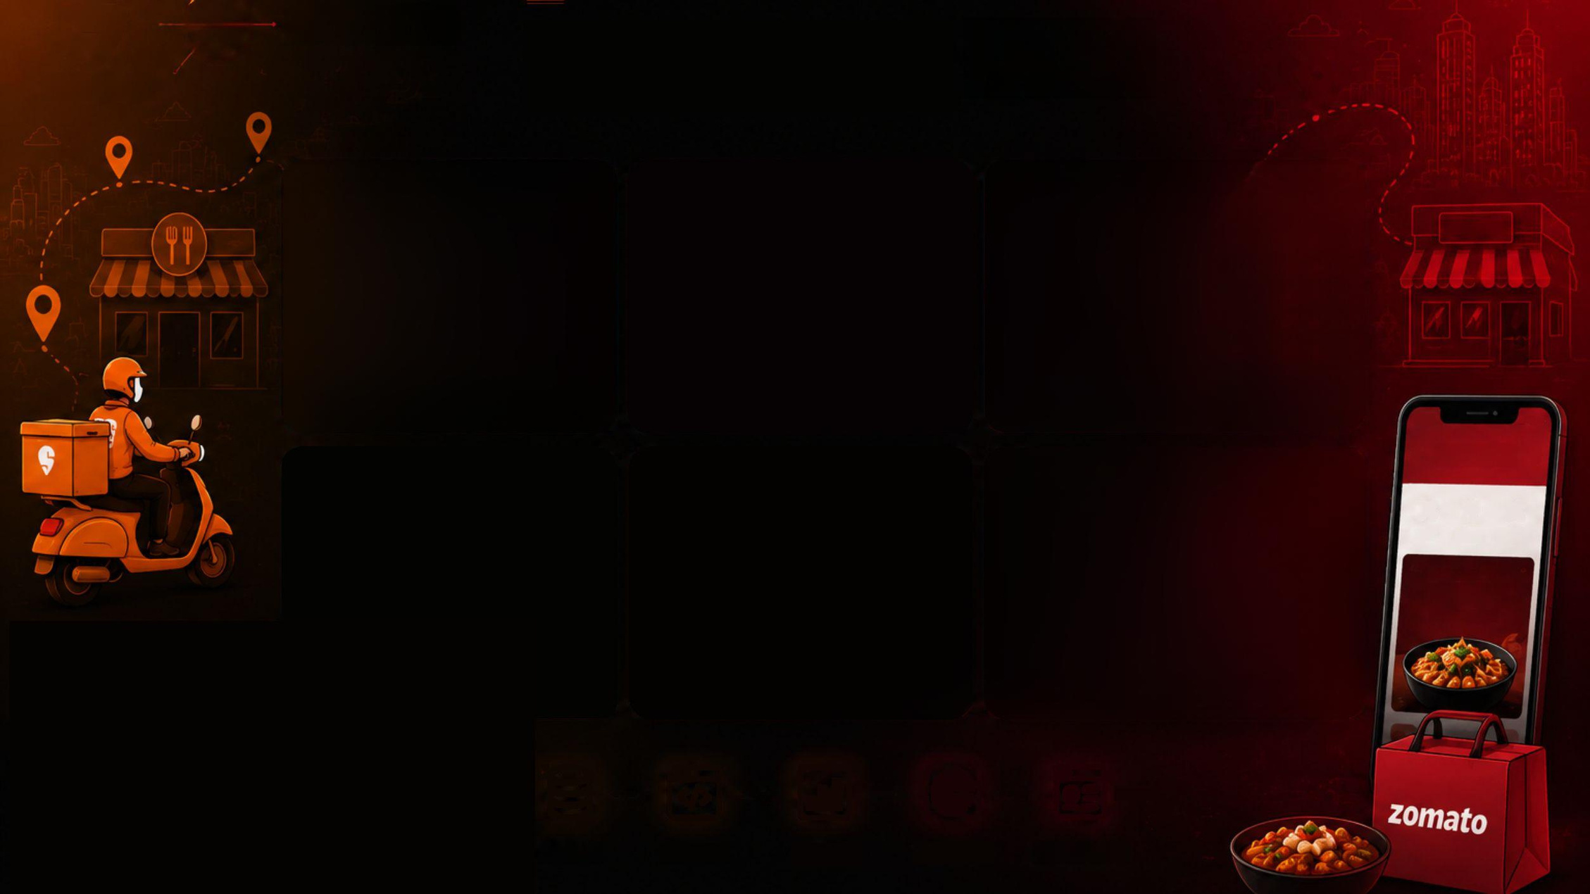























VS
zomato
Technology
Used
SWIGGY
Matplotlib/
Seaborn/Plotly express
Python
Pandas & NumPy
zomato
Core language for data processing and analysis.
Data wrangling, aggregation and
statistical computation.
Exploratory charts and correlation
visualizations.
zomato
Sroape
X
Excel / CSV
jupyter
Jupyter Notebook
Streamlit
Food
Dining
Nightlife
UPTO
Interactive analysis and
iterative experimentation.
50%OFF
Raw dataset storage and
initial inspection.
Used to build interactive graphs
and dashboards for data
analysis and visualization.
ON FIRST ORDER
Collect
Process
Analyze
Visualize
Dashboard

Slide 10
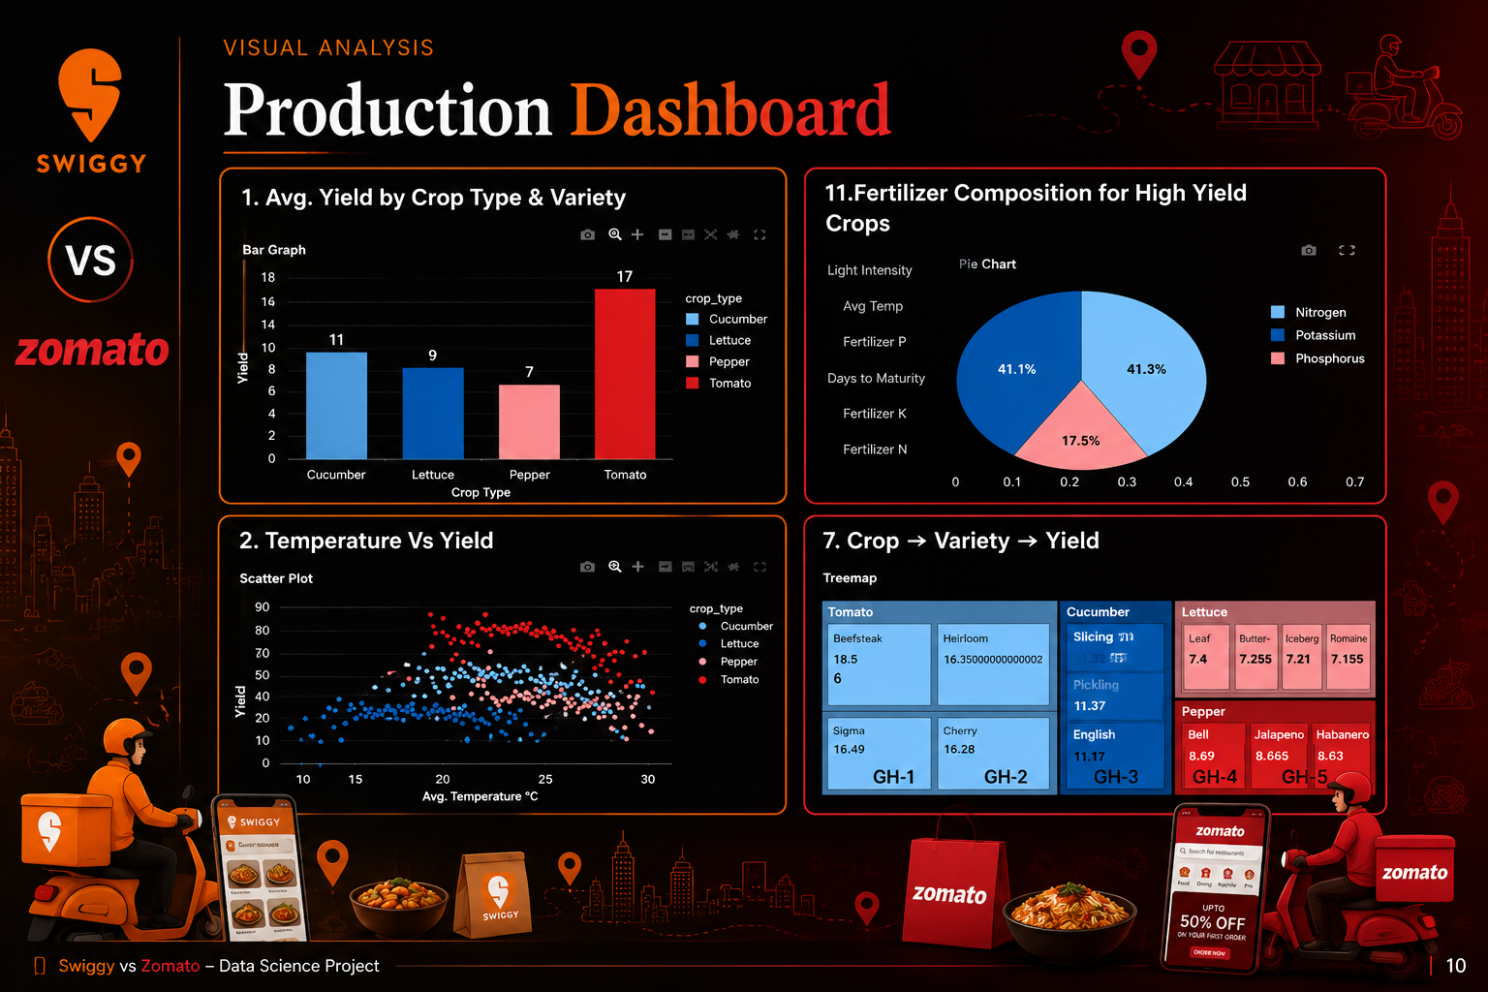
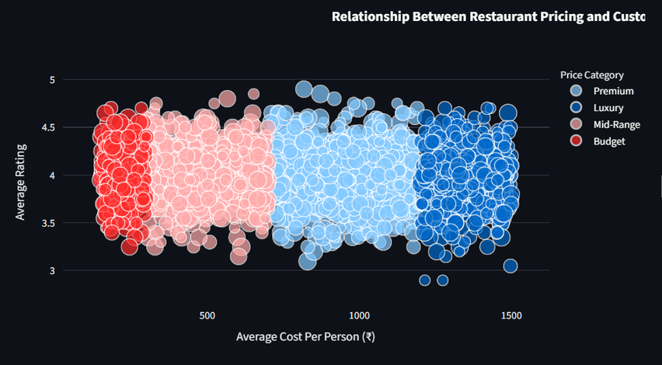
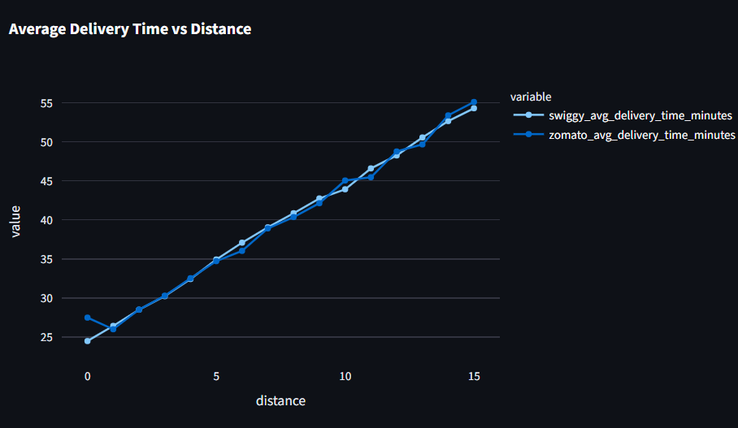
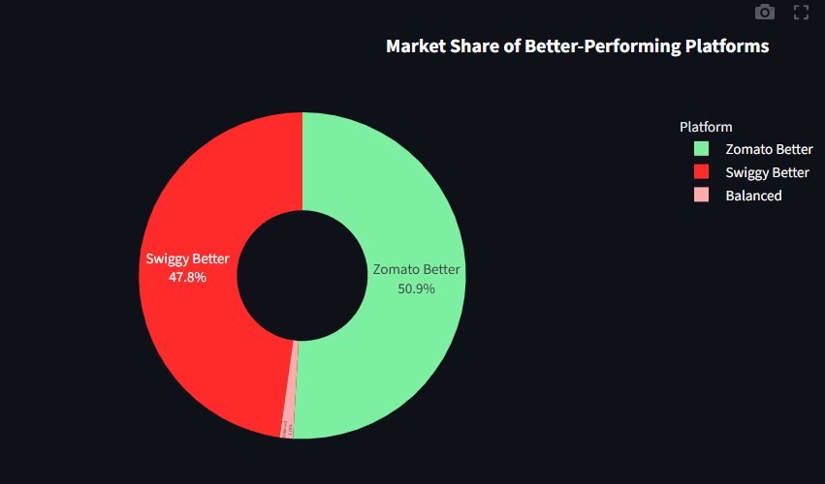
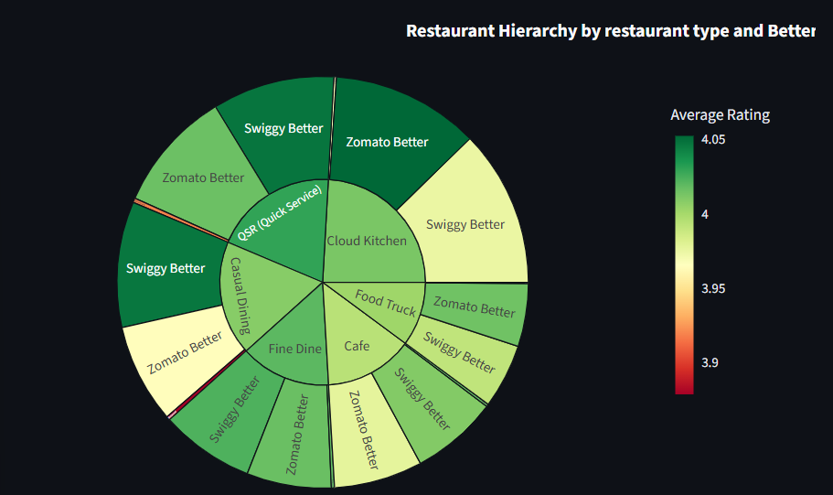

Slide 11


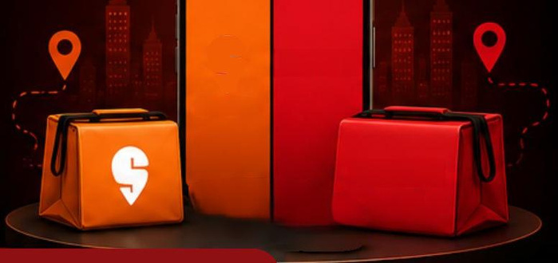




















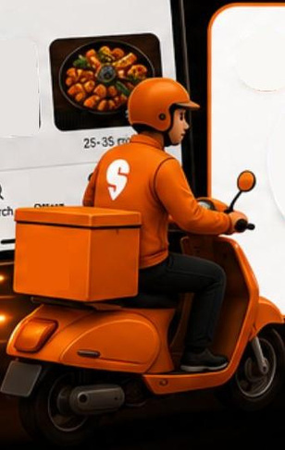















Key
Insights
zomato
VS
zomato
SWIGGY
SWIGGY
zomato
9:41
Delivery time increases with distance from the city center
Restaurant Price Category Distribution
SWIGGY
01
02
9:41
Search for restaurants
Restaurants located farther away require more travel time for deliveries. This highlights the importance of location in ensuring efficient food delivery.
The dataset is primarily composed of Budget and Mid-Range restaurants. Premium and Luxury restaurants represent a smaller share of the overall restaurant network. This indicates that affordable dining options dominate the dataset.
zomato
FOOD YOU LOVE,
DELIVERED FAST
Search for restaurants
GREAT FOOD
GREAT OFFERS
Food
Instamart
Genie
Dineout
Dining
Nightlife
Delivery
Events
Top Picks for You
Revenue and Orders by City & Restaurant Type
Impact of Restaurant Characteristics on Platform Performance
Top Rated Restaurants
03
04
39-48 on
4.5★
Revenue and monthly orders differ across cities and restaurant types. This highlights the influence of location and restaurant category on overall business performance.
Restaurant type, cuisine, price category, and location influence platform performance. These factors contribute to variations in ratings, orders, and revenue.
43*
30-40min
10-40 min
50-+400
43*
30-30or
30-35 min
Home
₹
zomato
Orders
Profile
Project:
SWIGGY VS ZOMATO: Restaurant Performance and Customer Insights Analysis

Slide 12
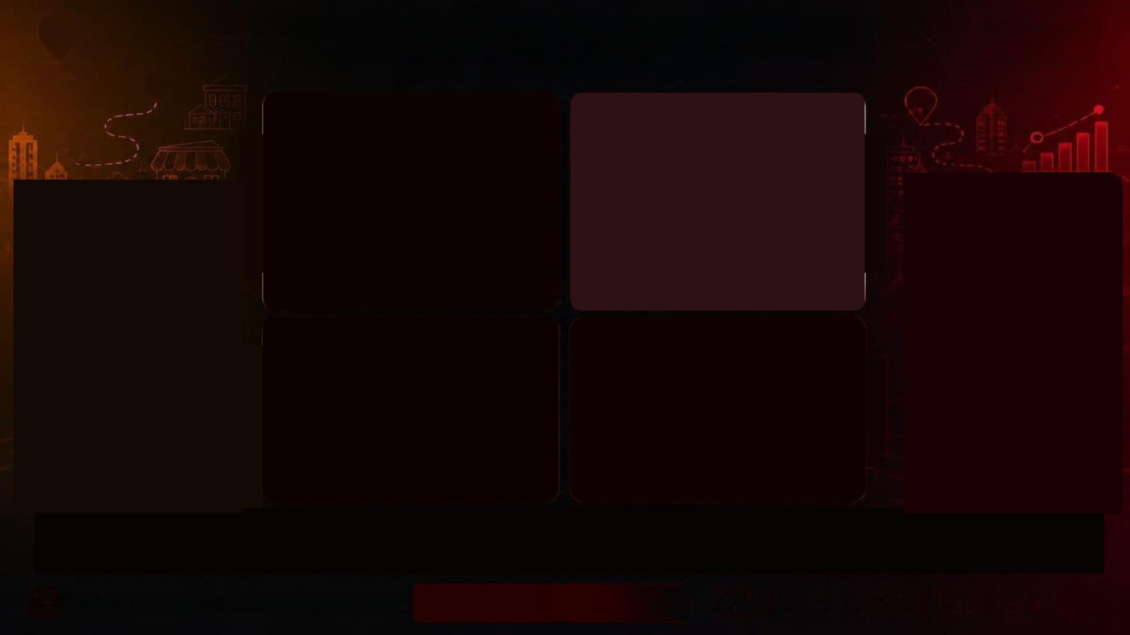










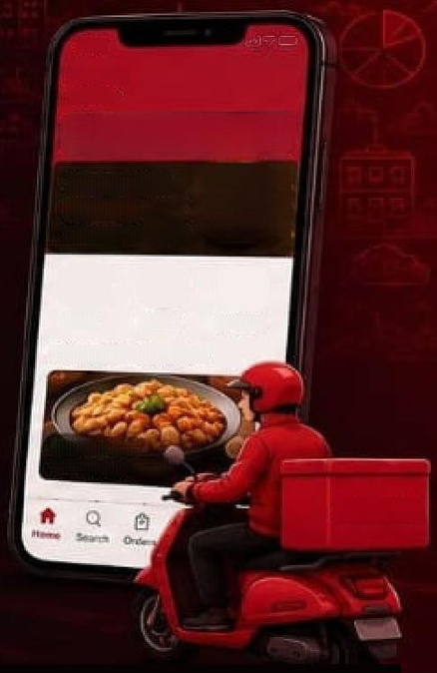









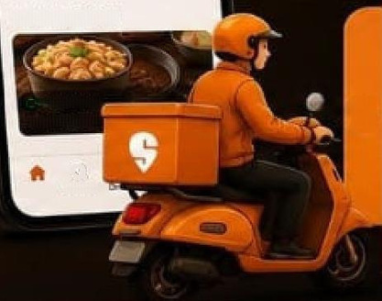











Conclusion & Future Scope
zomato
SWIGGY
Swiggy vs Zomato Platform Comparison
Discover more places.
More food.
Food you love,
delivered fast.
01
CONCLUSION
02
KEY FINDINGS
The project highlights that restaurant performance cannot be evaluated using only one parameter. A combination of ratings, orders, revenue, pricing, and operational metrics provides a more comprehensive understanding of platform performance.
    High customer ratings across most restaurants.
    Location impacts delivery efficiency.
    Revenue and orders differ by city and restaurant type.
    Restaurant characteristics influence platform performance.
లెటపే
క్రియిటి
Deiver io
Deiver to
Home
Work
Sosrch for restaurants
Search for restaurants
SWIGGY
instamart
zomato
10 mins delivery
GOLD
10% OFF on orders
Food
Instarmart
Gerke
Food
Drining
Hot-meal
Top Picks for You
Top Rated Restaurants
43•30mm
Biryani House
>
03
04
FINAL OUTCOME
FUTURE SCOPE
The project delivers an interactive and data-driven platform for analyzing and comparing Swiggy and Zomato, helping users gain meaningful insights into restaurant performance and business trends.
zomato
Searth
An AI-based recommendation system for personalized restaurant suggestions based on user preferences, budget, and ratings and real-time order tracking.
Project:
SWIGGY VS ZOMATO: Restaurant Performance and Customer Insights Analysis
12

Slide 13
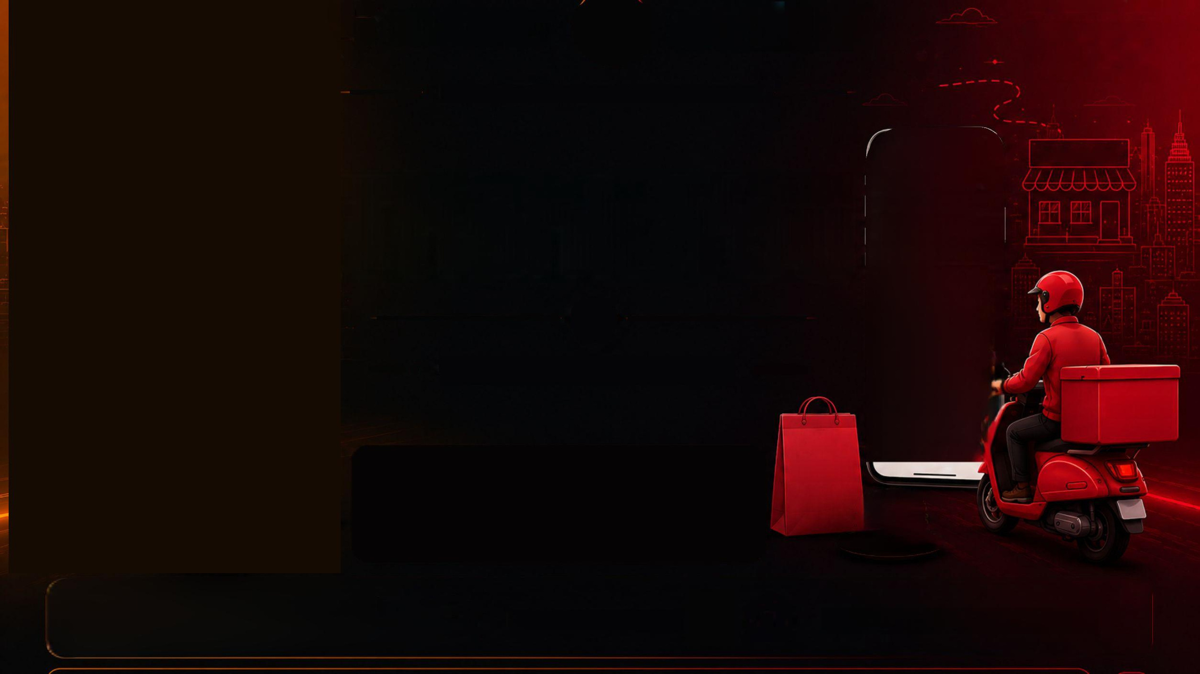
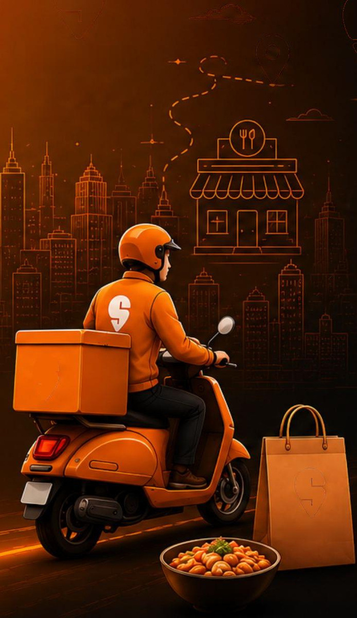





























zomato
zomato
Discover more places.
More food.
SWIGGY
VS
SWIGGY
Food you love,
delivered fast.
PLATFORM COMPARISON
981
RESTAURANT
zomato
Deliver to
Your Location
Thank You
Search for restaurants or cuisines
Food
Dining
Offers
Hot-meal
zomato
GOLD
Up to 30% OFF
+FREE dellvery
Questions & Discussion
zomato
Join Gold
Top Picks for You
See all
zomato
4.3|30mins
4.5 | 25 mins
zomato
Pizza
Burger
SWIGGY
FASTER
DELIVERY
WIDER
CHOICE
SMARTER
TECHNOLOGY
HAPPIER
CUSTOMERS
Presented by:
B.Tech CSE (AI & ML)
Sant Baba Bhag Singh University
Parneet Kaur

